Slide 1


Slide 2


Slide 3
What is a Human Resource?
Workforce or staff who occupy certain job to perform duties and responsibilities of a company.

Slide 4
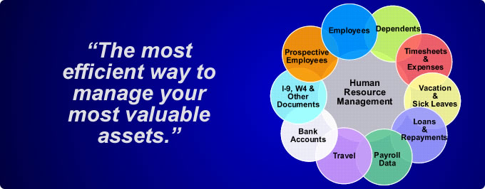

Slide 5
Why do we need human resource?
For managing the personal data.
Controlling authentication and authorization mechanism.
Evaluating employees’s performance.
Controls and manages the personal database.

Slide 6
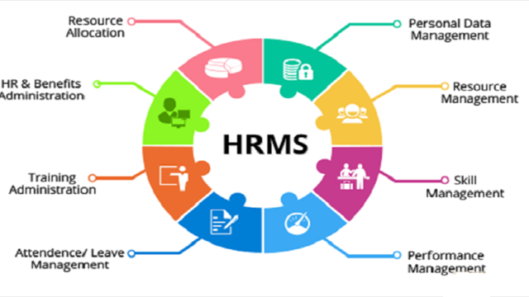

Slide 7
Users of the system are:
Administrator
HR head
Manager
Applicant

Slide 8
Tools Used:
Netbeans 7.1
MySQL(GUI Application used- SQLyog)
Technologies Used:
JSP
Servlet
HTML
JDBC

Slide 9
ADMIN
View his profile.
Update profile.
View and search all applicants
View and Search employees
List of interviewed and selected applicants
Update information of all employees

Slide 10
APPLICANT
View his profile.
Update profile
View interview schedule

Slide 11
HR HEAD
View his profile.
Update profile
View and search all applicants
Update applicant status and result
List of interviewed and selected applicants

Slide 12
MANAGER
View his profile.
Update profile.
View and search all applicants
View and Search employees
List of interviewed and selected applicants
View and Set Interview schedule
Send mail

Slide 13
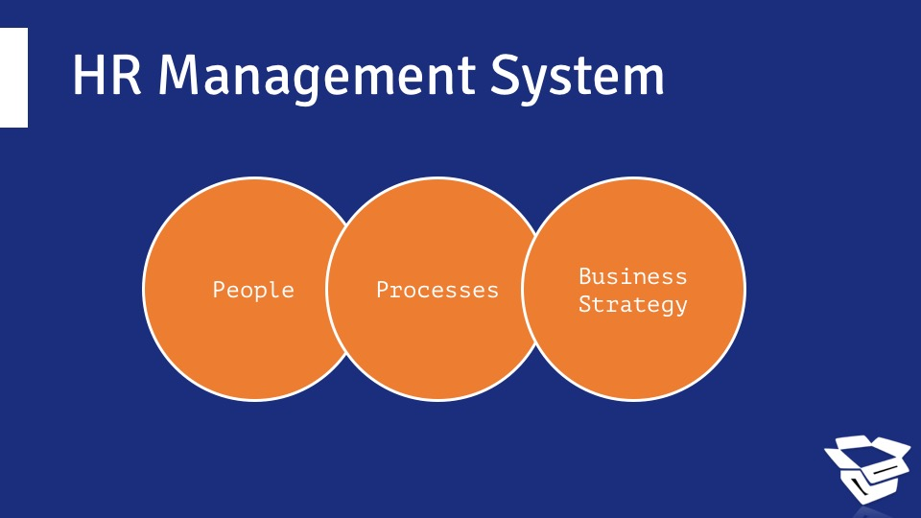

Slide 14
Advantages of proposed System :
Manually system changes into computerized system.
Friendly user interface.
Time saving.
Save paper work.
Give facility of different type of inquiry.
Simple interfacing both for administrator and general user.
Easy assistance for administrator and general user.
Easy to handle and access anywhere.

Slide 15
THANK YOU.

